Slide 1
Design for Verification Project Update
2021-10-04
Eldrick Millares (eldrick@stanford.edu)

Slide 2
Recap: CVA6 Deployment
Step 1: Instantiate simplified system with core + memory
Step 2: Add QED module, commit tracking logic, and current set of DFV constraints to core
Step 3: Iterate and constrain new uarch blocks (RV32I Only)
Step 4: Iterate and constrain 64b instructions, M/A/C ISA Extensions

Slide 3
Step 1 Completed
Step 1: Instantiate simplified system with core + memory*
Step 2: Add QED module, commit tracking logic, and current set of DFV constraints to core
Step 3: Iterate and constrain new uarch blocks (RV32I Only)
Step 4: Iterate and constrain 64b instructions, M/A/C ISA Extensions

Slide 4
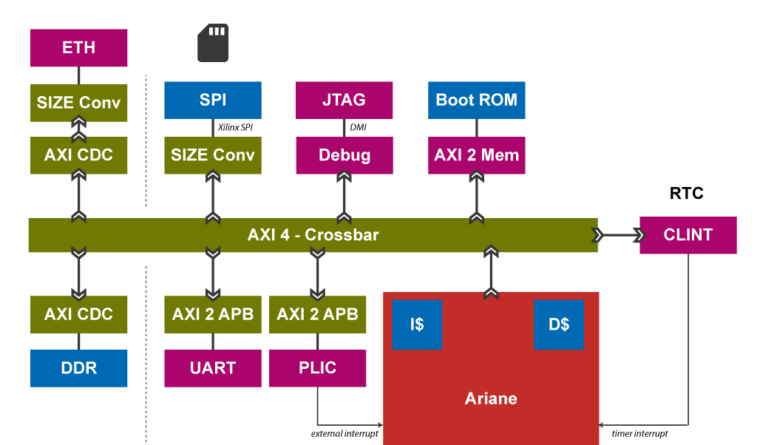

Slide 6
CVA6 Memory Interconnect Contains Comb. Loops
3 combinational loops found in the SoC involving DRAM signals
No modifications to these blocks - they are used as-is
Prevents formal tool from proceeding with compilation
Issue seems to be around valid <> ready handshaking handling

Slide 7
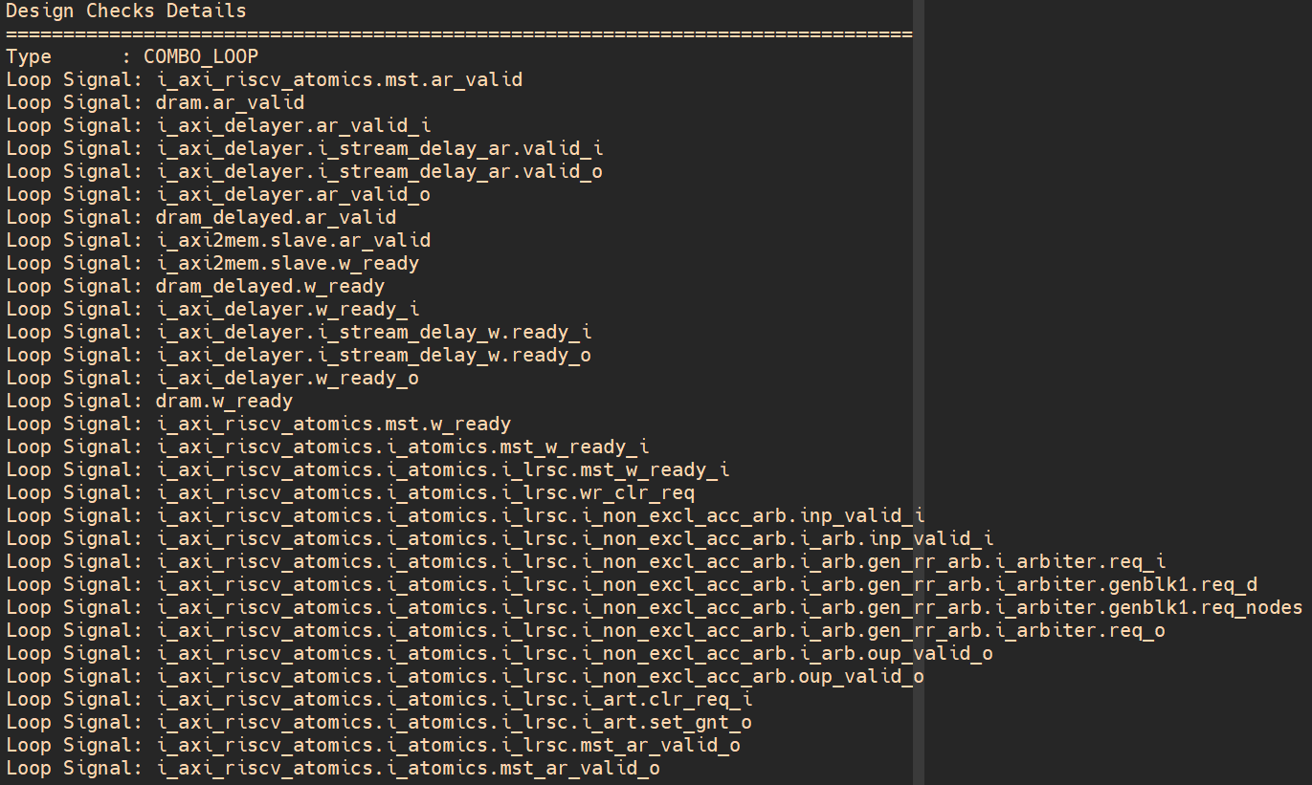

Slide 8
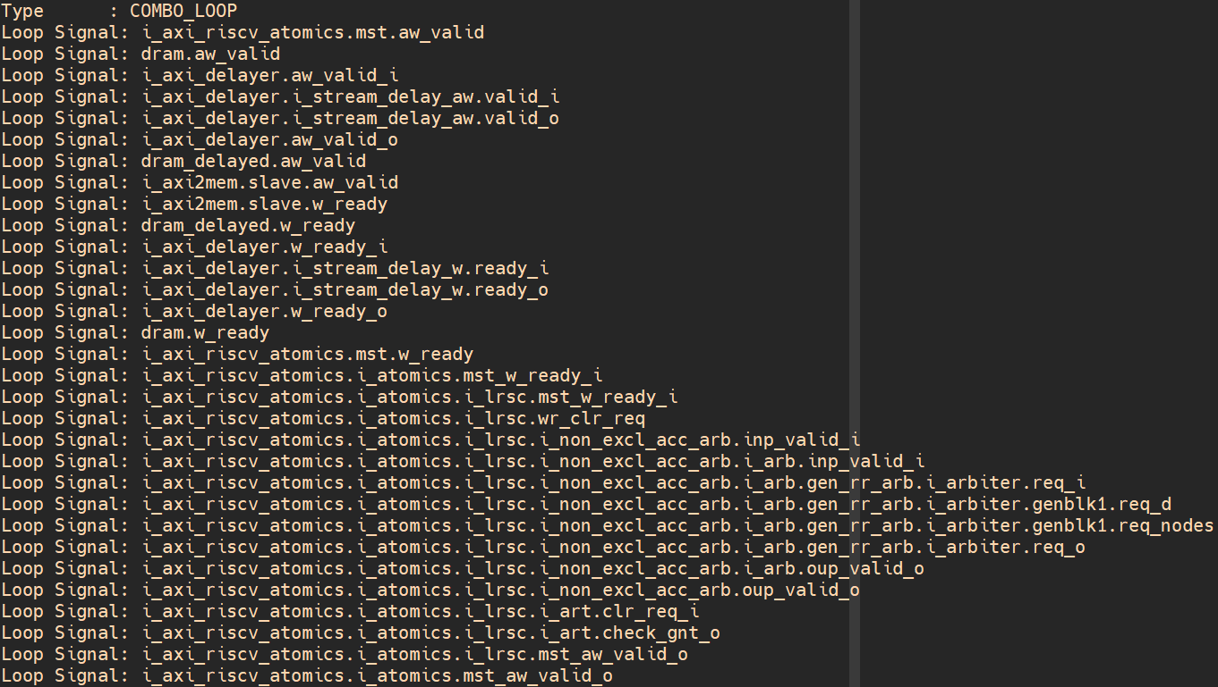

Slide 9
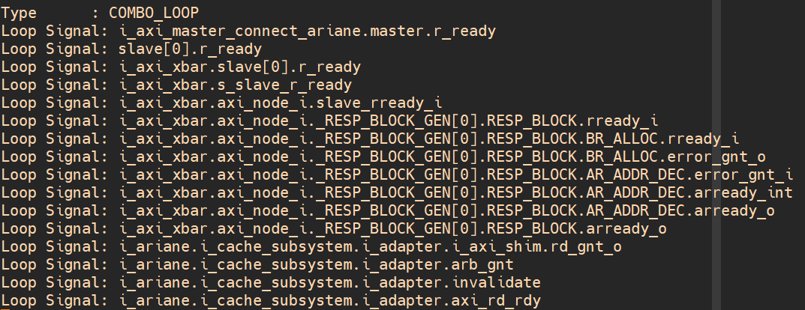

Slide 10
CVA6 Memory Interconnect Contains Comb. Loops
2 loops occur in an axi2mem module
Address {Read, Write} Valid <-> Write Ready
1 loop occurs in the AXI crossbar
Read Ready <-> Arbiter Grant
Have posted an issue ticket on GitHub for further advice

Slide 11
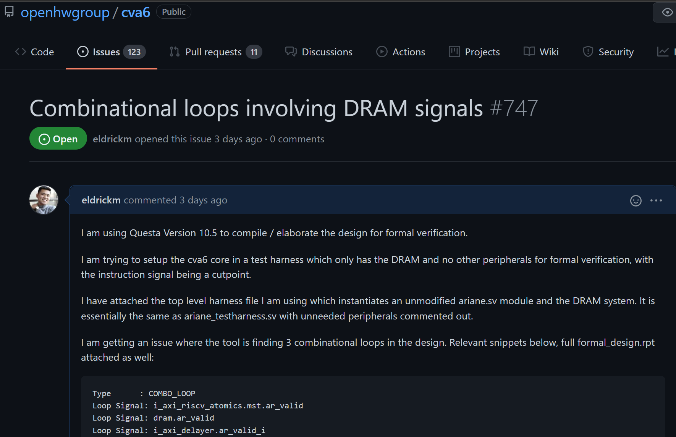

Slide 12
Workarounds
Disabled memory subsystem for now, instantiating core only
Does not gate integer register file checking
Waiting for guidance from maintainers
CVA6 code base is under a lot of flux due to a re-organization
Many recent bug fixes

Slide 13
Step 2 Completed
Step 1: Instantiate simplified system with core + memory*
Step 2: Add QED module, commit tracking logic, and current set of DFV constraints to core
Step 3: Iterate and constrain new uarch blocks (RV32I Only)
Step 4: Iterate and constrain 64b instructions, M/A/C ISA Extensions

Slide 14
Step 2 Details
Experimenting with SIF Commit tracking
IF -> ID interface (nominal SQED cutpoint) is not just a 32b instruction
Address
Instruction
Branch Predictor State
Exceptions

Slide 15
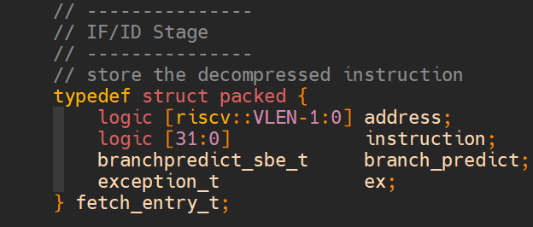
Notes:
4 typedef struct packed {
3 logic [riscv::VLEN-1:0] address; // the address of the instructions from below
2 logic [31:0] instruction; // instruction word
1 branchpredict_sbe_t branch_predict; // this field contains branch prediction information regarding the forward branch path
585 exception_t ex; // this field contains exceptions which might have happened earlier, e.g.: fetch exceptions

Slide 16
Step 2 Details
Experimenting with SIF Commit tracking
IF -> ID interface is not just a 32b instruction
Address
Instruction
Branch Predictor State
Exception State
To avoid over-constraining, moved instruction cutpoint earlier, within IF module.

Slide 17
Step 3 In Progress
Starting with only issuing NOPs and EDDI-V integer register file checking
Will use prior work on Ridecore to guide constraints

